Slide 1





Atlanta Cloud + AI Conference 2026
Shift-Left Performance Engineering
Implementing Performance Signatures in CI/CD Pipelines
What if every commit carried a performance verdict, automatically?
Code
Commit
Build
Test
Gate
Kandasamy Selvaraj

Slide 2

Performance Defects Are Expensive.
We Keep Finding Them Too Late.
1× to fix in development.
60 to 100× to fix in production.
Source: CISQ, 2022
Testing happens post-feature. Debugging context of code changes is already gone.
Specialized teams support and dependency that last hours or days to get feedback
Agentic AI is probabilistic, not deterministic, without guardrails, failures can cascade
Cost multiplier when defects reach production vs. development.
Pass/fail relies on manual, subjective interpretation.
Microservices make late-stage testing unpredictable.
Developers get no continuous feedback loop on performance.
Development
Integration
System Test
Pre-Production
Production
Low cost to fix
Rising cost
Higher cost
Very high cost
Extremely high

Slide 3



Every Commit Carries a Performance Verdict.
Here is how we make that happen automatically.
BEFORE
AFTER
Performance tested once, late in the cycle.
Performance validated at every code commit.
Manual expert reviews creating team bottlenecks.
Automated statistical gates. Zero specialist needed.
Static thresholds that go stale after each release and fiscal year.
AI-learned baselines that evolve with the system.
Feedback arrives days after the code was written.
Actionable feedback within 15 to 20 minutes.
This framework sits in the Agile/DevOps space: continuous, automated, and invisible to the developer once set up.
Feedback in 15 to 20 minutes. Self-service. Zero specialized expertise required.

Slide 4





Six Layers. One Pipeline. No Manual Gates.
A production-validated architecture where performance is enforced, not reviewed.
1
Developer Self-Service
Git-triggered pipelines, parameterized test scripts, 15-minute zero-expertise setup.
2
Pipeline Orchestration
Declarative DSL, performance signature gates at 99.5% accuracy, parallel execution.
3
Load Generation
JMeter 10 to 1K users, Kubernetes auto-scaling, real-time metrics streaming.
4
Observability Engine
Inject build context into traces. Your APM tool correlates commit to bottleneck automatically.
5
Data Persistence
30-day statistical baseline, trend analysis, adaptive threshold calibration.
6
AI Decision Layer
NEW
ML-powered go/no-go gate. Anomaly detection replaces static thresholds. Autonomous and explainable.

Slide 5






From Subjective Thresholds to Objective Statistical Performance Signature
| Current p90 — Baseline p90 |
Objectivity
Deviation
Score
=
Mathematically defined pass/fail.
Baseline Standard Deviation
Adaptability
Baselines evolve as the app improves.
50ms increase with 20ms σ = 2.5σ deviation
FLAGGED.
Sensitivity
Baselines built from 30 days of history, minimum 10 successful runs, using mean and standard deviation per metric.
Detects small but statistically significant regressions.
Transparency
Developers intuitively understand standard deviations.
The static threshold tells you whether a number is acceptable.
The deviation score tells you whether a number is normal.

Slide 6




Multi-Dimensional Performance Gate. No Guesswork.
Every dimension must pass. Break one and the build stops — with a reason.
METRIC CATEGORY
SPECIFIC METRICS
THRESHOLD
Response Time
p50, p90 latency
±2σ
Throughput
Requests per second
±2σ
Error Rate
HTTP errors, exceptions
+1% absolute
GATE TRIGGERED: Root cause analysis starts automatically.
Resource Utilization
CPU, memory, network
±3σ
Database Performance
Query time, connection count
±2σ
All five dimensions must pass. Your observability tool surfaces the why — not just the what.

Slide 7
Code Commit to Performance Verdict in 15 to 20 Minutes
1
2
3
4
5
6
7
8
Code Commit
Build & Unit Tests
Baseline Retrieval
JMeter Execution
Real-Time Monitoring
Metric Collection
Statistical Analysis
Performance Gate
Git webhook,
commit SHA + branch
Parallel CI compile
+ infra prep
30-day statistical
API query
Distributed load +
APM tagging headers
Live dashboards via
Prometheus
JTL + APM API
parallel aggregation
Deviation scores:
p50/p90, throughput
Pass: baseline updates.
Fail: root cause opens.
PASS
FAIL
In an Agentic AI pipeline, Steps 3 to 8 run autonomously.
The AI agent retrieves baselines, executes load, collects metrics, scores deviations, and issues a go/no-go with a plain-English explanation. No human in the loop.

Slide 8


Three Integration Patterns That Work With Any Stack
The tools are examples. The patterns are what matter.
Orchestration Pattern
Observability Pattern
Visibility Pattern
Jenkins ↔ JMeter
JMeter ↔ Your APM Tool
JMeter ↔ Grafana
Pipeline triggers load execution, parses results, and enforces performance gates on every build.
Inject build context into every request. Your observability layer correlates commit to bottleneck automatically.
Real-time metrics during the test. 90-day trend history across builds so teams see performance evolving over time.
// Inject build context into every load test request — works with i.e Dynatrace, Datadog, New Relic, or any APM
httpSampler.addNonEncodedArgument("X-Build-ID", "${BUILD_ID}", "");
httpSampler.addNonEncodedArgument("X-Commit-SHA", "${GIT_COMMIT}", "");
httpSampler.addNonEncodedArgument("X-Branch", "${BRANCH_NAME}", "");
// Your APM now links every trace back to the exact commit that triggered it
Tag your traffic. Any APM that reads HTTP headers can now trace a performance problem back to the exact commit.

Slide 9



How We Did It: 8 Weeks.
A real microservices system. No shortcuts.
SYSTEM UNDER TEST
8-WEEK IMPLEMENTATION TIMELINE
50+ microservices: Java Spring Boot + React
Week 1
← Start here today
IaC provisioning + AI-assisted config generation for Jenkins, Prometheus, Grafana, your APM tool.
Kubernetes on Cloud
Weeks 2 to 3
LLM generates JMeter scripts from OpenAPI specs and production traffic logs.
Weeks 4 to 5
RDS + Redis Cache + Event Streaming Platform
Declarative DSL, performance signature gates, adaptive baseline tuning.
Week 6
~ Around 50,000 - 80,000 requests/minute peak load
Top 5 critical workflows with intelligent gate validation.
Weeks 7 to 8
AI-generated runbooks, self-service templates, team onboarding.
How we measured it:
We tracked the same metrics for 6 months before rollout, then 6 months after. Same system, same conditions, no cherry-picking.

Slide 10
Performance Problems Caught Earlier.
Fewer Reaching Production.
BEFORE
AFTER
CHANGE
Defects Found in Development
18%
58%
+222%
Defects Found in Test
35%
31%
-11.4%
MTTD (hours)
52.3
0.4
-99.2%
MTTD: 52 hours → 24 minutes.
Immediate automated feedback fundamentally changes operational efficiency.

Slide 11
Beyond Numbers: Culture and Developer Experience
91%
Self Service Model
Increased confidence in their own code performance
Faster feature delivery and reduced incidents
Improve overall application Performance and SLA/SLO compliance
of failures came with an automated root cause.
Nobody had to investigate manually. The system told them where to look.
ROOT CAUSE BREAKDOWN (APM Tool)
38%
Database query inefficiencies
27%
N+1 queries and duplicate API calls
18%
Thread and connection contention
14%
Infrastructure constraints
3%
Other
When developers trust the feedback loop, they stop avoiding performance. That cultural shift showed up in the data: 30% faster delivery and 60% fewer escalations.

Slide 12
Honest Constraints and Lessons Learned
No framework is perfect. Here is what we learned the hard way.
Key Limitations
Proven Best Practices
Cold start takes 5 to 10 runs.
Start with your highest-risk journeys.
The AI needs data before it can gate reliably. We hardcoded manual thresholds for the first sprint. Plan for it.
Pick the 5 workflows that would cost the most if they regressed. Prove value there first, then expand.
18 minutes adds up for fast teams.
Run 10 successful tests before enabling gates.
High-frequency commit teams felt the pipeline drag. We moved performance gates to nightly for those branches.
Gates armed too early produce noise. Patience in week 1,2 saves frustration in weeks 3 through 8.
Training still takes 6 to 8 hours.
Celebrate developers who catch their own regressions.
Self-service templates helped but did not replace onboarding. Budget a interactive 2 to 3 hour session per team, not an email.
Culture follows incentives. Public credit for self-caught issues changed behavior faster than any tool.

Slide 13


The Foundation for Next-Generation Performance Engineering
-30 to 40%
-44%
-30%
98.9%
Days → Minutes
Performance Issues
Response Time
Release Cycle
Gate Accuracy
MTTD
Statistical baseline comparison transforms performance gates from subjective manual interpretation to objective, reproducible, automated decisions — making performance a natural part of every developer's workflow.
AI-Enhanced Test Generation
Predictive Performance Analysis
Open Telemetry Standardization
Shift-Right Integration
ML-based test plan synthesis from production traffic.
Predict regression risk before execution runs.
Replace proprietary instrumentation with vendor-neutral tracing.
Synthetic monitoring and progressive delivery with automated rollback.
"As software architectures grow increasingly complex, automated continuous performance validation becomes essential rather than optional."

Slide 14














Fast Feedback Is Not the Same as Full Validation.
Pipeline performance testing and full-scale performance engineering are not competitors. They are partners. You need both.
What Shift-Left Pipeline Testing Gives You
What Your Performance Engineering Team Validates
Catches regressions at commit time before they compound.
Stress tests at 10× or more of production load — not possible in pipeline environments.
Developer feedback in 15 to 20 minutes per build.
Soak testing over hours or days to expose memory leaks and gradual degradation.
Runs lightweight in controlled environments like DIT and FIT.
Full production data volumes, topology, and real-world service interdependencies.
Scoped to a single change — not the full platform.
Regulated industry sign-off — financial services, healthcare, and compliance-driven capacity evidence.
Empowers developers to own their own performance quality.
End-to-end business journey simulation across all services simultaneously.
Full-scale performance engineering validates the whole system under real-world conditions.
Full-scale performance engineering validates what only emerges under production-scale stress, sustained load, and compound system behaviour. The performance engineering team owns the latter. Developers own the former.

Slide 15
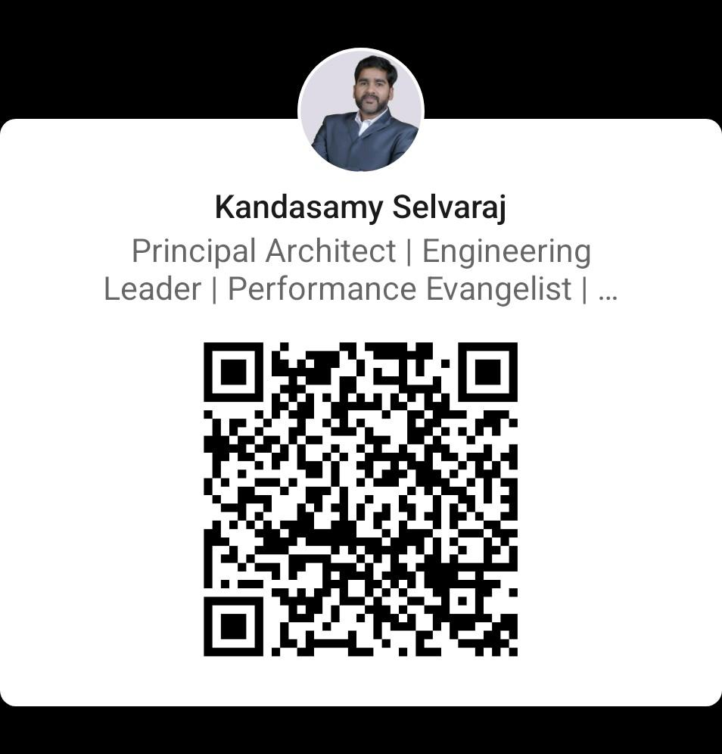


Your pipeline has no memory.
Fix that this week.
1
Start Week 1 today.
2
Tag your traffic.
3
Set one gate.
Pick your top 3 highest-risk user journeys. Everything else can wait.
Add X-Build-ID and X-Commit-SHA headers to your load tests. Any observability tool reads them.
Response time p90 ±2σ. Just one. Ship it. Add the rest next sprint.
linkedin.com/in/kandasamy-selvaraj-3ab97835/
Resources and templates shared after the talk.
https://github.com/kandasamyperf-stack/perf-grimoire
Atlanta Cloud + AI Conference 2026

Slide 16
